Slide 1
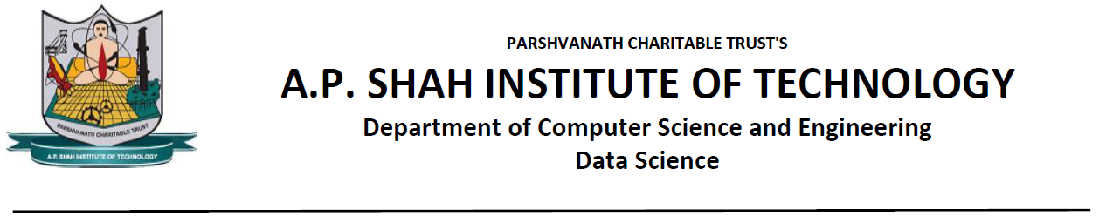
BUS RESERVATION SYSTEM
Group members:
Priyanshu Worlikar - 22207001
Harshad Raurale - 22207002
Sneha Sabat - 22207008
Vineet Mhatre - 22207009
Project Guide -
Prof. Rajashri Chaudhari
Notes:
1

Slide 2
Contents
Introduction
Objectives
Scope
Features / Functionality
Project Outcomes
Technology Stack
Block Diagram
Notes:
2

Slide 3
1. Introduction
Problem Identified :
It is often see that, when we have to travel to some place via bus, it is very hectic to buy tickets/reserve set at the time of departure. The queues are very long, etc.
Solution Proposed :
To over come this problem we have developed the bus seat reservation system, which will help the user to book seats, at his comfort without having to stand in long queues and saving users time.
Notes:
3

Slide 4
2. Objectives
To make the booking process faster, convenient and comfortable.
To overcome the problem of having to visit the office and wait in long queue.
To provide the service of reserving the seat 24x7 and from the comfort of the user.
To save users precious time.
Notes:
4

Slide 5
3. Scope
A bus booking system allows potential customers to self book
and pay through your own website.
2. Bus Booking System is a web based application which is
connected to a complete database.
It helps to securely store customer’s data.
The customers can book their ticket in their own comfort
any time.
Notes:
5

Slide 6
4. Feature /Functionality
Feature 1 :
Login and New User Registration
Feature 2 :
Easy Booking and Cancellation of Ticket.
Feature 3 :
Add Balance to the account and View Ticket.
Feature 4 :
• Instant and contact-free payments
Notes:
6

Slide 7
5. Outcome of Project
User Can login and register
User Can Add Balance
Used can book ticket by providing following inputs
Loction.
Time.
User can View the Ticket.
Notes:
7

Slide 8
6. Technology Stack
Xampp 8.0.25/PHP 8.0.25
MySQL 8.0.31
NetBeans 11.1
JDK-19
Notes:
8

Slide 9
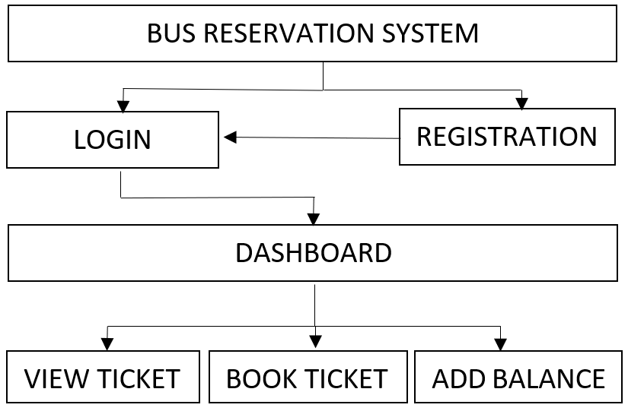
7. Block Diagram
Notes:
9

Slide 10
Thank You...!!
Notes:
10

